Slide 1
Predictive Analytics in the Music Industry: Enhancing Hit Song Identification for Record Companies
Dharva Khambholia
Leah Mesfin Eyob
Marco Tang

Slide 2
Motivation of Research
When Music companies like Sony Music, EMI receive thousand of different Demo songs daily, what can they do to ensure they won’t miss the next Grammy Award？
How can they ensure their music will be popular among the world so they don’t waste what they invested in?
How can they find the pattern of popular songs?
Notes:
Have you ever throught about how to create popular songs, is it because of the song’s lyric, singers, or the song’s rhythm, how should a music company analysis the song more efficiently? Just imagine, music and record company like sony music might be receiving over housand of different Demo songs, beside of listen all the songs, how can they ensure they won’t miss the next Grammy Award winning album?
Marco

Slide 3

Research Question
What are the key song features or characteristics that strongly correlate with the levels of song streaming numbers in the music industry?
Notes:
Therefore, we came up with our research question what are the key song features or characteristics that strongly correlate with the levels of song streaming numbers in the music industry?
Marco

Slide 4
Dataset Overview
Target : “Streams”, this is the total number of stream for the songs
Features: released_year : Such as in_spotify_playlists, in_spotify_charts, in_apple_playlists, in_apple_charts
Processing: Split the data into 70% train and 30% test dataset.
Final sample size: (953, 24)
Data source: https://www.kaggle.com/datasets/nelgiriyewithana/top-spotify-songs-2023
Notes:
This dataset contains a comprehensive list of the most famous songs of 2023 as listed on Spotify. The dataset offers a wealth of features beyond what is typically available in similar datasets. It provides insights into each song's attributes, popularity, and presence on various music platforms
Dharva

Slide 5
Streams Categories
Class 0 | 0 to 0.53 Billion
Class 1 | 0.53 to 1.05 Billiom
Class 2 | 1.05 to 1.59 Billion
Class 3 | 1.59 to 2.12 Billion
Class 4 | 2.12 to 2.65 Billion
Class 5 | 2.65 to 3.17 Billion
Class 6 | 3.17 to 3.7 Billion
Notes:
Dharva

Slide 6
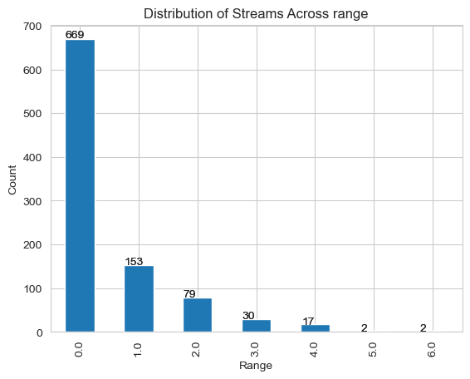
Streams range Most streamed songs
Track_name | Streams
Blinding Lights | 3.7 billion
Shape of You | 3.6 billion
Someone You Loved | 2.9 billion
Dance Monkey | 2.9 billion
Sunflower - Spider-Man: Into the Spider-Verse | 2.8 billion
Notes:
Dharva

Slide 7
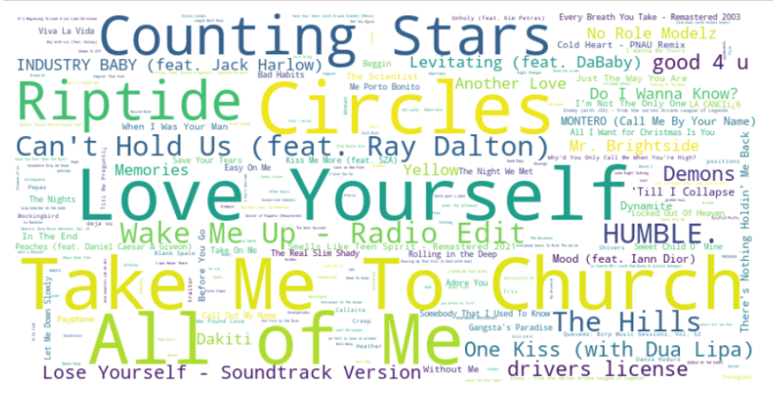
Notes:
Dharva

Slide 8
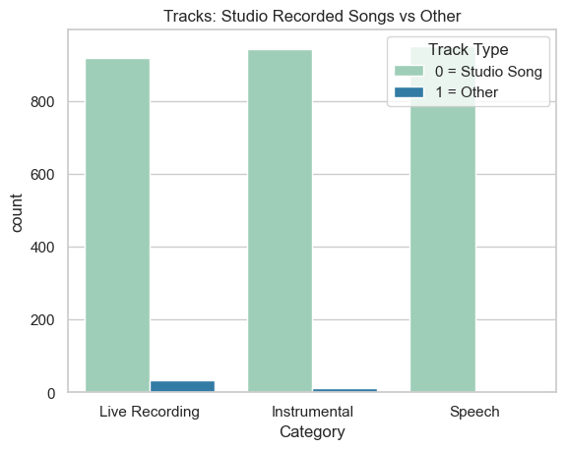
Exploratory Data Analysis

Slide 9
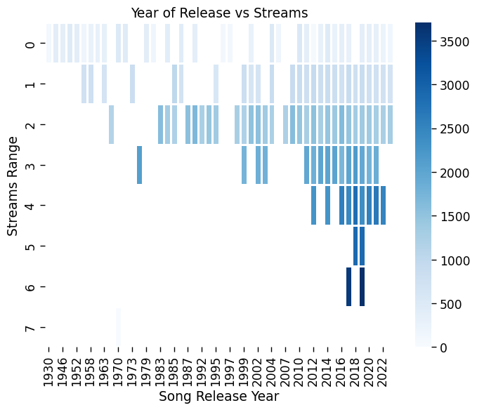
Year of Release
Songs that are more recent have higher streams general
We should not focus on repromoting music before 2010

Slide 10
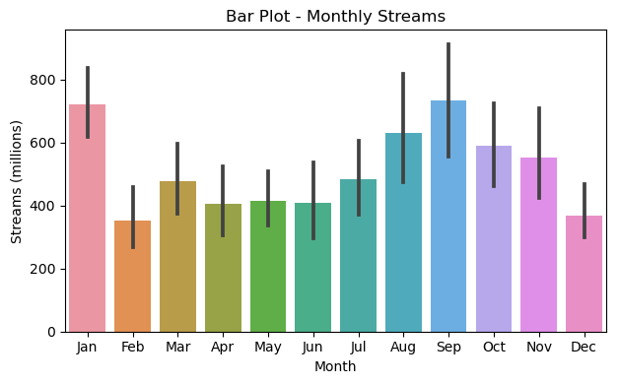
Month of Release
January and September are the best month to release music
February and December are the worst months to release music

Slide 11
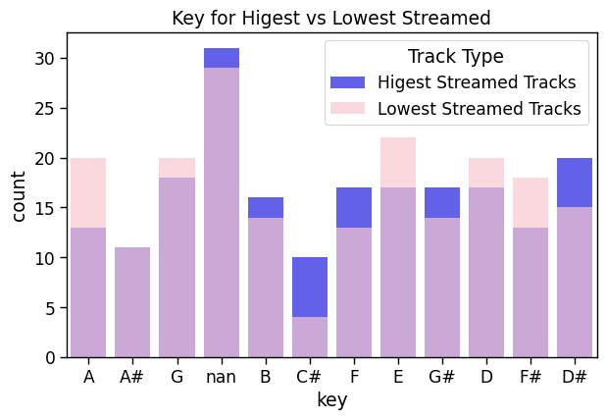
Highest Streamed Keys:
B, C#, F, G#, D#
Lowest Streamed Keys
A, G, E, D, F#

Slide 12
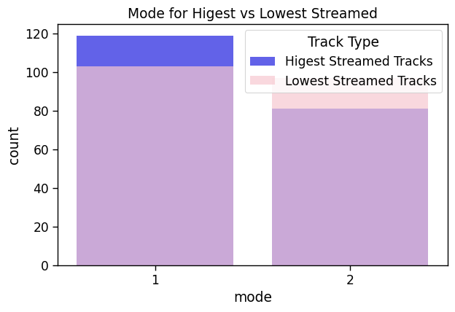

Slide 13
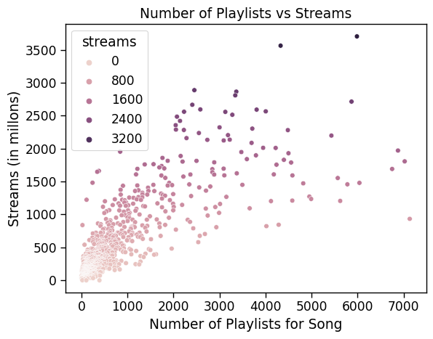
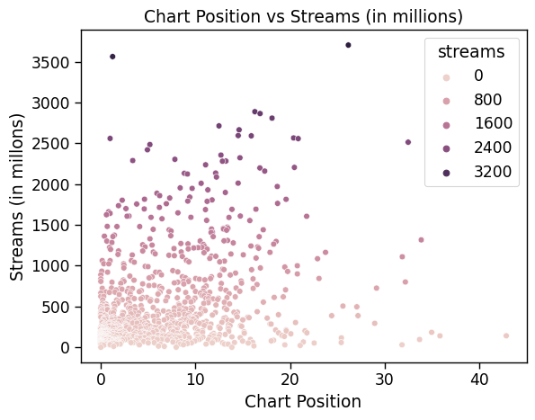
Charts vs Playlists
Notes:
Leah

Slide 14
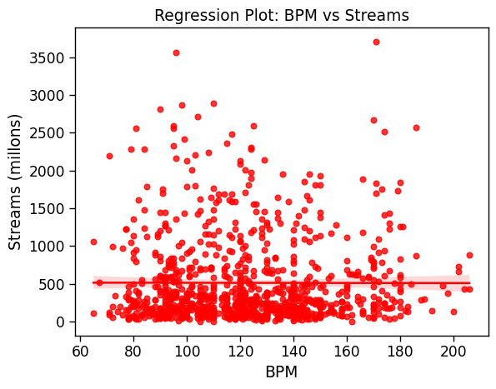
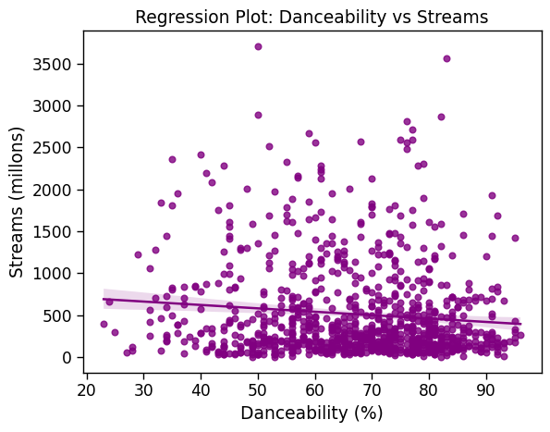
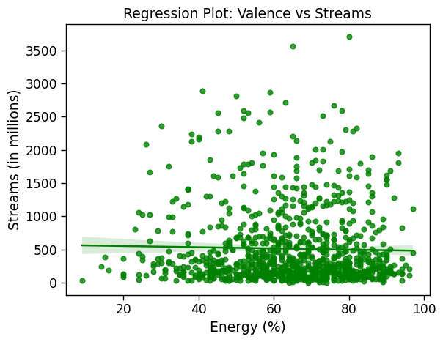
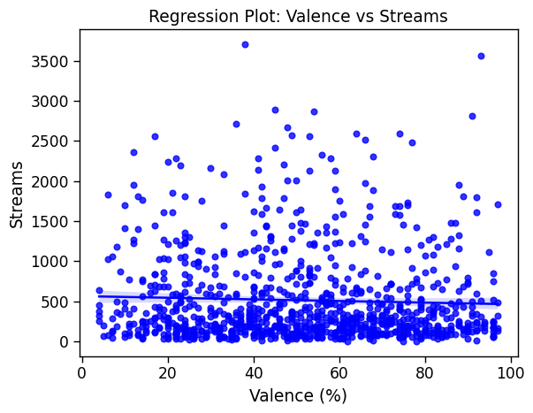
afdadfasss

Slide 15
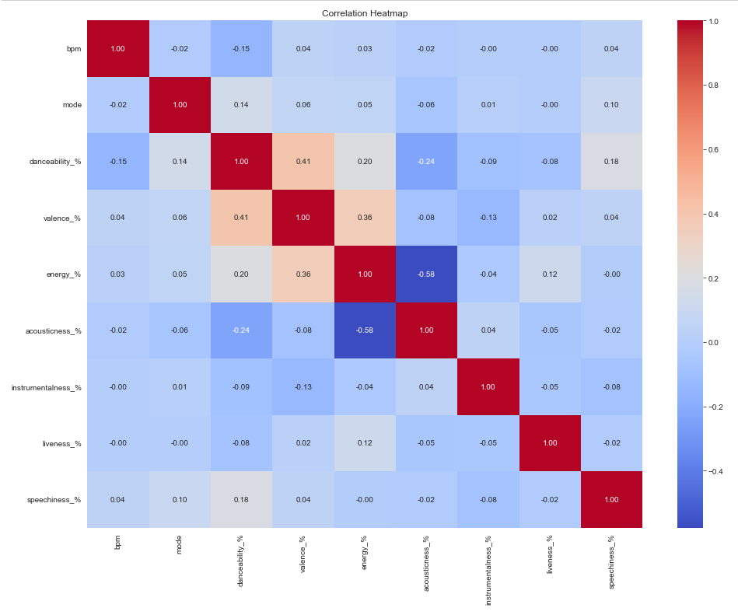
Correlation among song characeristics
Notes:
Dharva

Slide 16
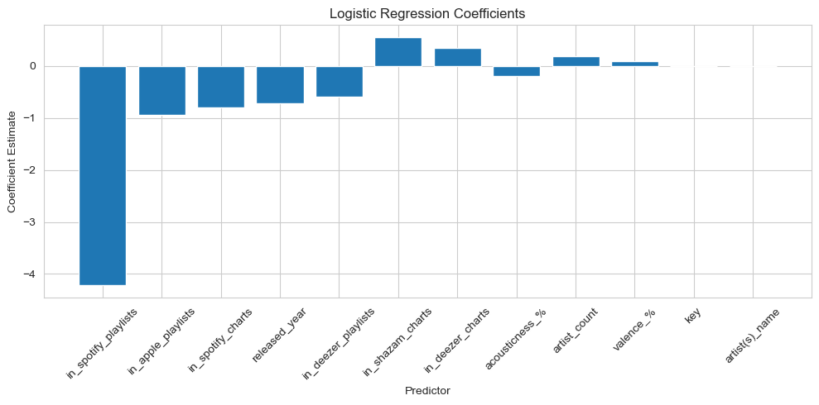
Logistic Regression
Accuracy: 78.32%
Notes:
Marco
· In this slide we can see that logistic regression model that was built using a backward selection—where variables are sequentially deduct from the model based on their statistical significance. The model predicts the likelihood of the stream number of the song, using predictors such as 'released year', 'in_spotify_playlists', which shows that a negative coefficient for popularity suggests if the song were added more frequently in to the 'spotify_playlists decreases the likelihood of the song being successful, while showing the positive coefficient for shazam_charts and the likelihood of song being popular . The model's accuracy is reported at 78.32%, meaning it has a high accuracy.

Slide 17
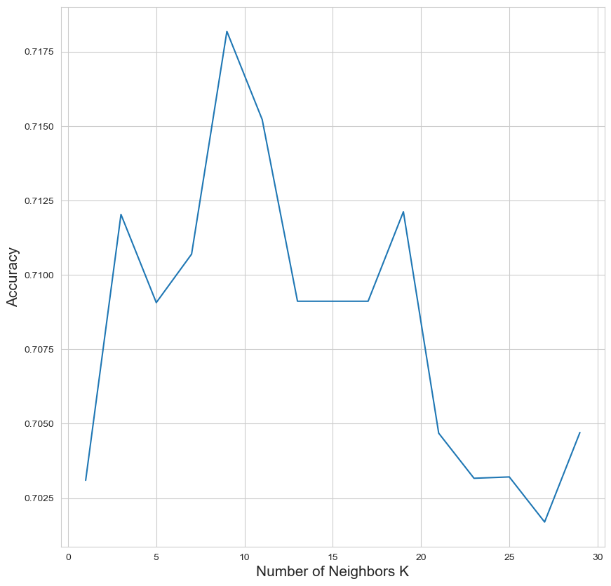
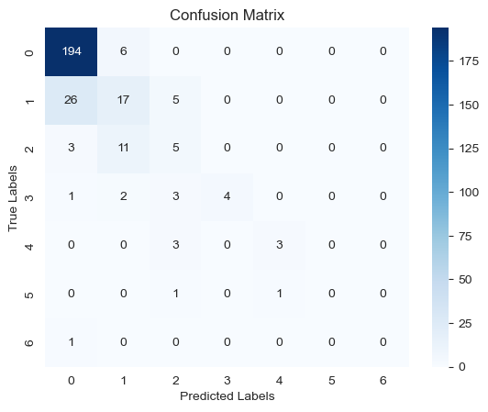
KNN
K =8
Accuracy: 76.67%
Notes:
Marco:
The diagonal numbers represent correct classifications:
For class 0, there are 194 songs correctly predicted to be in their actual popularity class.
For class 1, there are 17 songs correctly predicted.
For class 2, there are 11 songs correctly predicted.
it seems that for class 3, there are no correct predictions (if there is a class 3 at all, as the numbers are a bit unclear for this class in your matrix).
The off-diagonal numbers represent incorrect classifications, where the model has predicted a different class than the actual class:
6 songs that were actually in class 0 were predicted to be in class 1.
26 songs that were actually in class 1 were predicted to be in class 0.
5 songs that were actually in class 1 were predicted to be in class 2.
And so on for the rest of the matrix.

Slide 18
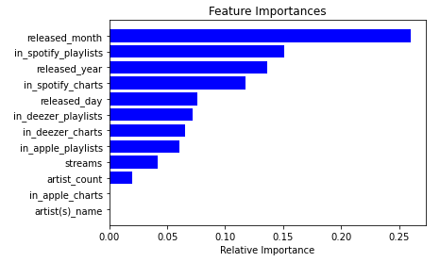
Random Forest
Releasing Month played the most important role in predicting the number of streams of a song
We found out that the best season to release a song was September
Accuracy: 77.27%
Notes:
Dharva
By visualizing the feature importance in predicting the streams of a song, We can delve deeper into the model and know which of these features are more influential in the model and are significant predictors.
So From the list of important features we have here, ‘released_month’ is the most important feature in the model prediction as compared to other features but this doesn’t mean that the other features do not contribute towards making predictions. It is just a relative ranking of importance within the model.

Slide 19
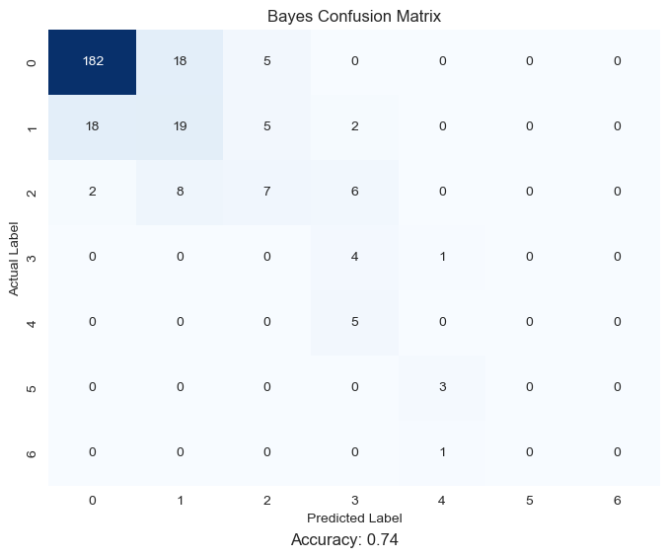
Naive bayes
Accuracy: 74%
Notes:
Leah
good at classifying with a smaller dataset
precision recall f1-score support
0 0.90 0.89 0.89 205
1 0.42 0.43 0.43 44
2 0.41 0.30 0.35 23
3 0.24 0.80 0.36 5
4 0.00 0.00 0.00 5
5 0.00 0.00 0.00 3
6 0.00 0.00 0.00 1
accuracy 0.74 286
macro avg 0.28 0.35 0.29 286
weighted avg 0.75 0.74 0.74 286

Slide 20
Conclusion and Future Work
Music companies can use these models to predict the popularity of a Demo they might receive over the year.
Music companies can also understand what are the main factors to determine a successful and profitable song
To improve the models, we need to continue update the dataset with more popular songs
Research for other song features
Compare our model with other advanced models in order to create the best possible model.
Notes:
Marco
Increase the potential market shares
Reduce the risk of failure
key
valence_%
acousticness
Too many class 0

Slide 21
THANK YOU

